Slide 1
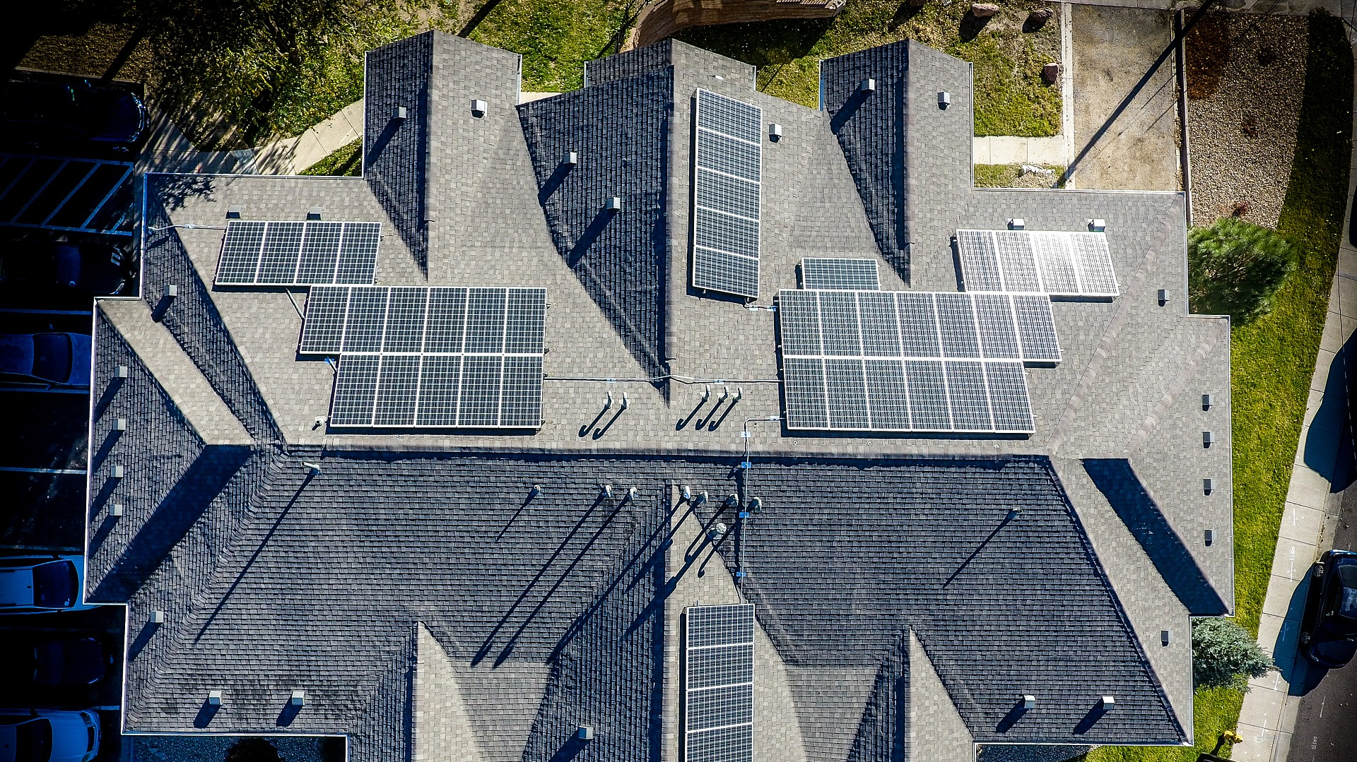


Energyducation student competition
Supported by:
Notes:
Today we intoduce the Energyducation competition
Attention: there are slides with a pink rectangle. These slides need to be adapted by the individual teacher!
Information to the Lecture notes:
Regular speaker notes
Descriptions regarding student tasks or further information
Sources: at the end of the notes – Picture sources or further reading
Feel free to hold the lesson in the language you feel most comfortable in. The materials are in English but you can translate slides if you like to
If English is in your curriculum, it can be beneficial to hold these first two sustainability lessons in English even if you conduct the whole program in your mother tongue
Some slides are deactivated: here you can choose which slides you like to show.

Slide 2

Energyducation competition
concept
What is it about?
Who is involved?
How does it work?

Slide 3

European project
Competition by
Notes:
The competition is part of the European VET Education and Training Project «Energyducation».
The Swiss climate protection foundation myclimate developed this competition. As it is a new project, it is the first time the competition takes place with international VET Students.
More about the project: www.energyducation.eu

Slide 4

Notes:
https://youtu.be/lWnJfdD6_4k
The climate protection foundation myclimate works in climate education, Consulting and solutions and climate protection projects all around the world.
More: www.myclimate.org

Slide 5

What is it about?

Slide 6

Who:
VET students – like you!
Competition
What:
International competition
How:
Develop business ideas
About:
Smart Energy management

Slide 7
Educational goals of competition
Goal 1: Motivate students in vocational education to work on projects through an international competition
Goal 2: Learn business and presentation skills while solving an energy problem using smart energy solutions in an innovative and creative way
Goal 3: Enable international exchange between VET students
Notes:
To your information: These are the educational goals of the competition.
You do not need to tell the students the goals but if someone asks, you have them ready

Slide 8

Who is involved?

Slide 9









6 schools in 5 countries
Lulea Kommun
Vocational Training and Education School,
Lulea, Sweden
Alfa College
Vocational Training and Education School
Groningen, Netherlands
CIFP Usurbil LHII
Vocational Training and Education School, Basque Country
Hans-Böckler-Berufskolleg
Vocational Training and Education School
Münster, Germany
hftm Höhere Fachschule Technik Mittelland
Voc.Training and Education Grenchen, Switzerland
Polybau Utzwil
Vocational Training and Education School
Utzwil, Switzerland

Slide 10
Schools and students participating
Country | Profession | Classes
Netherlands | Electrician, installation and human technology | 2 classes
Germany | Electrotechnicians and building technicians | 1 classes
Spain | Higher technician in energy efficiency and solar thermal energy | 1 class
Sweden | Electrical and automation engineer; HVAC (Heating, Ventilation and Air Conditioning) and energy engineer | 1 class
Switzerland | Facade construction, Automation engineers | 2 classes in 2 schools

Slide 11

How does it work?

Slide 12
Competition
Adapt dates to your timeline
January - March
Work on student projects
10. April
Hand-in (EN)
May
May
Schools choose 3 best projects
Int. Jury chooses best projects overall
Winners announced
June
Winners trip to smart house in Germany
Projects online
Notes:
January: Task and problem are given:
Start individually: coordinated with tandem class → over more or less the same timeframe
April: Beginning of April: latest point to hand in projects to teacher (also presentations)
End of April: Teachers choose best projects of their classes → myclimate
Mai: International Jury (Steering group members?) choose best projects
Mai: all projects are presented online and winners announced
June: Trip for winners to Germany

Slide 13
What are prerequisites for participants
Enrolled in VET classes for a profession where Smart Energy is relevant
Basic understanding of Smart Energy principles and solutions (i.e. toolkit)
Basic knowledge of English (A2+)

Slide 14

Projects
Students in vocational education work on team-projects for an international competition
Problem:
School without Smart Energy solutions
Task:
Find an innovative solution using smart energy tools
Hand-in:
Business model for your solution and short video presentation
Good projects are:
Innovative
Save energy
Interesting in design of product or solution
(Ecologically) sustainable
Presented well
Teams of
2-3 students
Notes:
More information is in the student booklet and the teacher guide.

Slide 15
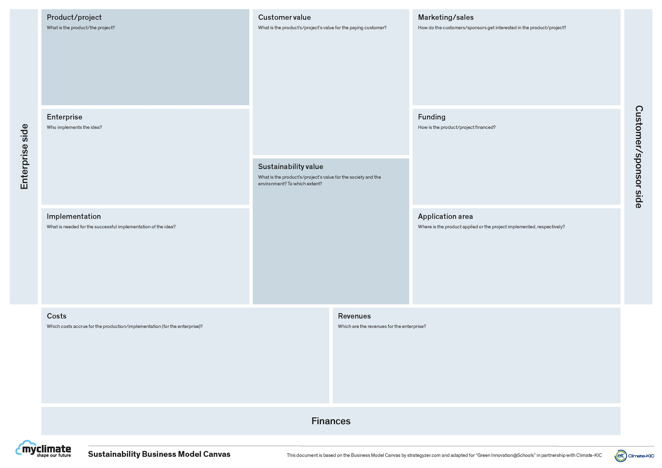

Hand-in to competition
Sustainable business model for your product or solution
Present your idea in a short video (maximum 90s)

Slide 16
Innovative smart energy solution → Hand-in
Sustainable business model
Present an innovative smart
energy product/system
Present video in class +
Hand in Business Model to teacher
Teacher chooses best 2-3 projects
Jury chooses international winners from these projects
Winners get to go on a study trip to Germany!

Slide 17


International exchange
Tandem classes in two countries
Teams in tandem classes paired up
Medium: skype calls for 2-3 exchanges
Possible: Chat for other questions
Teams are not dependent on the work of their tandem partner, but are encouraged to support each other

Slide 18
6 Participants in 5 countries
Lulea Kommun
Vocational Training and Education School,
Lulea, Sweden
Alfa College
Vocational Training and Education School
Groningen, Netherlands
CIFP Usurbil LHII
Vocational Training and Education School, Basque Country
Example
Hans-Böckler-Berufskolleg
Vocational Training and Education School
Münster, Germany
hftm Höhere Fachschule Technik Mittelland
Voc.Training and Education Grenchen, Switzerland
Polybau Utzwil
Vocational Training and Education School
Utzwil, Switzerland
Notes:
Each class has a tandem class in another country. Each project team will have a tandem project team in this class.
The teams will support each other and get to know each other over the time of the project.

Slide 19
3 Exchange Skype Calls
Meeting 1: Get to know tandem team
Meeting 2: Present concept to tandem team
Meeting 3: Present final project to tandem team

Slide 20
Individual program
Adapt dates to your timeline

Slide 21
Project groups
Put list of student groups
or how many groups you want

Slide 22
Preparations for exchange
Exchange «teacher adress» with your Skype adress
Skype account
Every group needs a Skype account
Log in or register on https://www.skype.com/en/get-skype/
Send your Skype adress to your teacher under teacher@adress.eu
Test Skype by calling another group: Make sure video and audio works for you both
Notes:
Tutorial here:
https://edu.gcfglobal.org/en/skype-2016/

